Slide 1

What transport problems can high speed rail address and what opportunities can it enable? A route geography approach
ECONOMIC CONNECTIONS
Phil Potterton
ATRF Conference 2024
Melbourne
27-29 November 2024
Transport economics and policy analysis – connecting people, goods and places.
Notes:
How does the business case for Sydney to Newcastle high speed rail relate to the business case for Sydney-Brisbane?
One answer is that Sydney-Newcastle comprises around 20 per cent of a straighter, shorter, faster Sydney-Brisbane route. You can’t complete the second without undertaking the first.
Another answer is that the problems and opportunities of Sydney-Newcastle are very different from those of Sydney-Brisbane. Identifying problems and opportunities are where both the Infrastructure Australia guidelines and the ATAP guidelines encourage us to start the process of developing and analysing projects.
I was thinking about all this early in the year following Minister Catherine King’s announcement of the Sydney-Newcastle business case. I landed on the ‘route geography’ idea and hence this paper.
And here I’d like to thank the two anonymous referees who provided some helpful criticisms of the draft paper submitted in May.

Slide 2
What transport problems can HSR address and what opportunities can it enable? A route geography approach
Context and rail definitions
What network and service footprint for the paper?
Route geography – concept, descriptions
Transport problems of the route geographies
How can high speed rail ‘solve’ the transport problems?
Resulting opportunities
Business case implications
Transport economics and policy analysis – connecting people, goods and places.
Notes:
So I’m going to talk about:
Rail definitions
The network and service footprint analysed in the paper
The route geography idea and application
Transport problems of the route geographies
Addressing the problems with high speed rail
Resulting opportunities and
Business case implications

Slide 3
Defining ‘high speed rail’
Service type | Max train operating speed kph | Infrastructure
High speed rail (HSR) | 300-350 | Electrified
Sub-high speed (sub-HSR) | 200-250 | Electrified
Transport economics and policy analysis – connecting people, goods and places.
Notes:
The top row is essentially as per the High Speed Rail Authority Act, which defines high speed trains as ‘capable of travelling at speeds exceeding 250 km/hr’ and with observed top operating speeds often between 300 and 350.
The second row, sub-high speed rail, is my own term, used here, for clarity and where services would also require a fully electrified network.

Slide 4
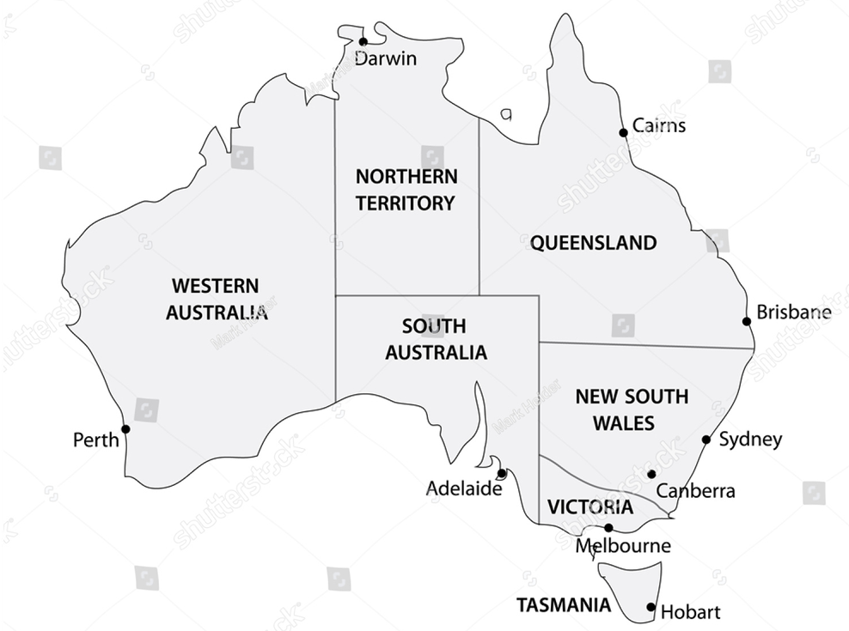
Network: Brisbane-Sydney-Melbourne-Adelaide
Services: include sub-high speed, esp. at shorter distances
Transport economics and policy analysis – connecting people, goods and places.
Notes:
In the paper I explain the network and service mix that I’ve adopted here by reference to international experience and Australia’s economic geography. Here, I’ll just tell you that the network comprises the 2,600 km from Brisbane to Sydney to Melbourne to Adelaide, including spur lines to the Gold Coast and Canberra.
This is as per the High Speed Rail Authority Act with the addition of Melbourne-Adelaide.
Regarding services, I consider sub high speed as well as high speed ones – another addition to what’s in the Act.

Slide 5
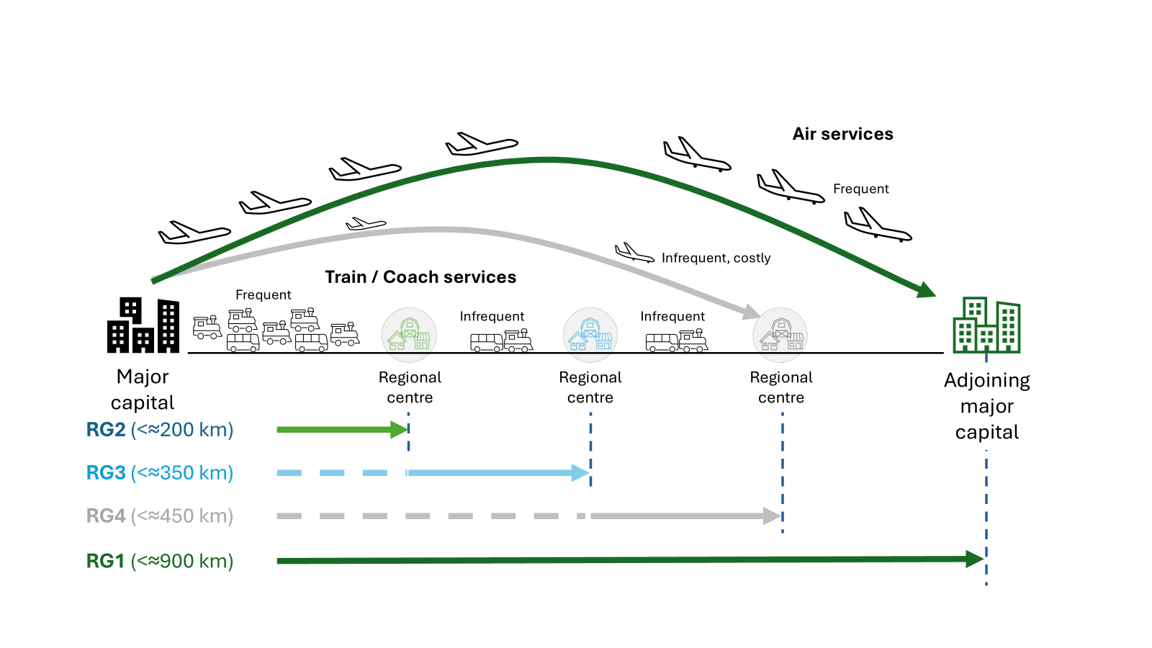
Brisbane-Sydney, Sydney-Melbourne corridors each display 4 route geographies
Transport economics and policy analysis – connecting people, goods and places.
Notes:
There are four route geographies and the Brisbane-Sydney and Sydney-Melbourne corridors display each of the four.
Route geographies are groupings of city pairs and a major capital is at one end of each pair. In that sense it’ s very major capital centred concept.

Slide 6
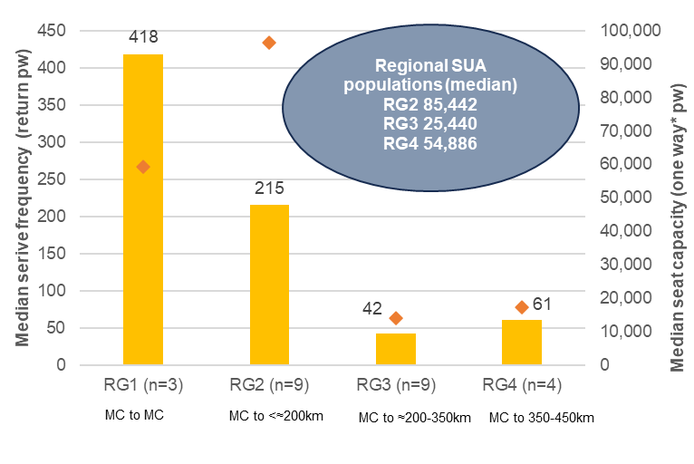
Frequencies – very high in RG1, high in RG2 low in RG3 and RG4
Transport economics and policy analysis – connecting people, goods and places.
Notes:
Route geographies can differ in the modes available, level of fares and frequencies – let’s start with frequencies, based on data compiled in April and May.
There is a median level of over 400 weekly return services on routes between adjoining major capitals (RG1) and over 200 per week in the band from major capitals up to the end point of frequent train service, at not more than 200 km distance (RG2).
The orange diamond shows seat capacity, which is highest in RG2, with trains having mostly more seats than the aircraft in use in RG1.
Frequencies fall sharply in RG3. That’s from the end point of frequent train service up to 350 km from the nearest major capital. Frequencies increase only slightly in RG4, which is from 350 to 450 km.
And just to explain, RG4 ends at around 450 km, because RG3 lies beyond it – measured this time from the adjoining major capital end. That is, going back to the previous slide, all of those arrows apply in the other direction as well.

Slide 7
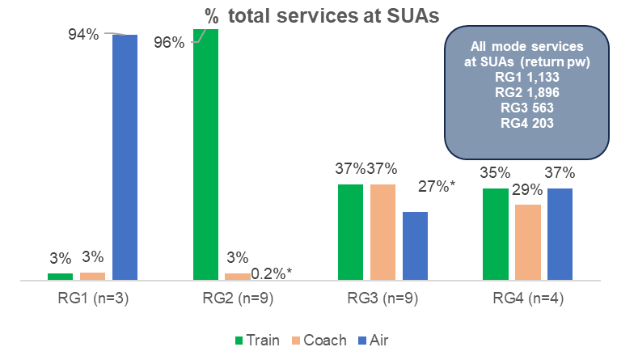
Mode balance – air preponderant in RG1, train in RG2, train & coach RG3, all 3 RG4
MC to MC
MC to <≈200km
MC to ≈200-350km
MC to 350-450km
* RG2 Newcastle only RG3 Canberra only
Transport economics and policy analysis – connecting people, goods and places.
Notes:
Looking at modes available, RG1 between the major capitals and RG2 close to capitals are similar in the sense that each has over 90 per cent of services in a single mode, air in RG1 and train in RG2.
I describe RG3 as a train and coach route geography, but you’ll see three bars there, rather than just two, with the blue one standing for air. That is the one exception, Canberra, which has frequent air service to Sydney that make up as much as 27 per cent of total services in the band.
In RG4 all regional centres have air service, as well as train and coach.

Slide 8
Route geography transport problems mostly involve not meeting benchmark service times
Commuting benchmark Up to 1 hour
(Business) day return benchmark Up to 2-3, 3-4 hours
Australian ‘east coast’ end to end air trips ≈3½ hours (95 mins + 2 hr ‘excess’)
Transport economics and policy analysis – connecting people, goods and places.
Notes:
On to the transport problems.
Not meeting benchmark service times for commuting trips and business day return trips is key to identifying the problems.
For commuting, the benchmark is the one hour maximum idea, while for day return travel it’s more of a range.
The literature tends to focus on three hours one way as the limit for a viable day return trip. I estimate three and a half hours as the critical benchmark in Australia, based on scheduled air service times on east coast routes between adoining major capitals and applying a standard literature-based two hour air versus rail ‘excess’.
The excess reflects three things: time to and from airports – longer, for many travellers, by comparison with centrally located stations – time at airports and a passenger preference for rail over air, based mainly on comfort and reliability factors.

Slide 9
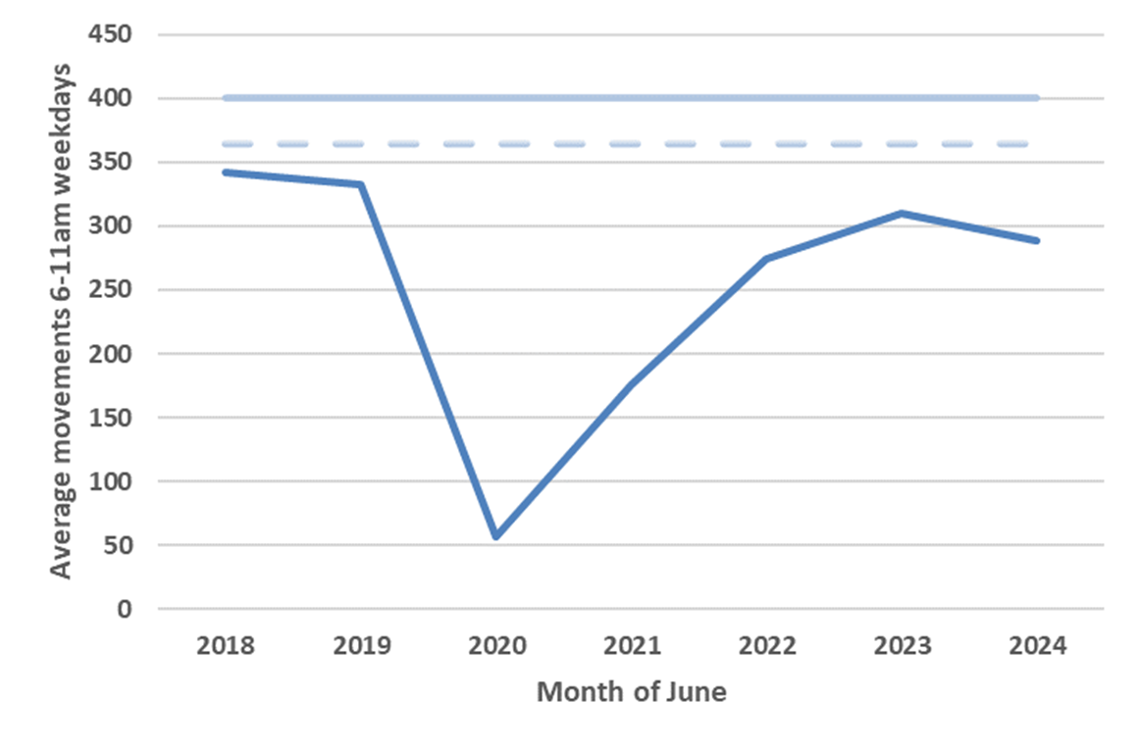
RG1 A future problem – Sydney Airport’s runway capacity caps growth in 3½ hour journeys
80 flights per hr legislated cap
73 flights per hr ‘de facto’ cap
Source: Airservices Australia (various years), Sydney Airport operational statistics,
Sydney Airport Corporation 2023, Sydney Airport’s Aviation Green Paper Submission
and author analysis
Transport economics and policy analysis – connecting people, goods and places.
Notes:
So what is the transport problem between major capitals? It’s all about aviation.
In the years before COVID, Sydney Airport was regarded as pretty much at capacity during the weekday morning peak. There’s some leeway at present, as you can see on the chart, but not all that much. Recent flight numbers have been around 85 per cent of the pre COVID level.
Western Sydney International Airport is due to open in 2026, but the difficulty for intercapital travellers to and from central Sydney, as passenger demand grows over time, is that journeys will be about 40 minutes longer each way. That’s the extra driving time from Badgerys Creek to the centre compared with from Mascot to the centre.

Slide 10
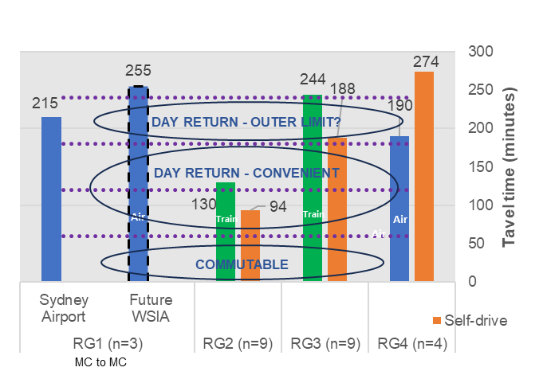
RG1 Western Sydney Int. Airport – too far for <4 hour east coast trips to or from Sydney’s east
Air
MC to ≈200-350km
MC to 350-450km
Transport economics and policy analysis – connecting people, goods and places.
Notes:
And as the second bar from the left shows, that takes you to over four hours for a one way day trip – ie an estimated 255 minutes, compared with 215 currently.
So business and the community will face higher costs, either in converting day trips into longer trips, or by paying a growing premium in order to continue to be able to travel via the in demand, well located Sydney Airport.

Slide 11
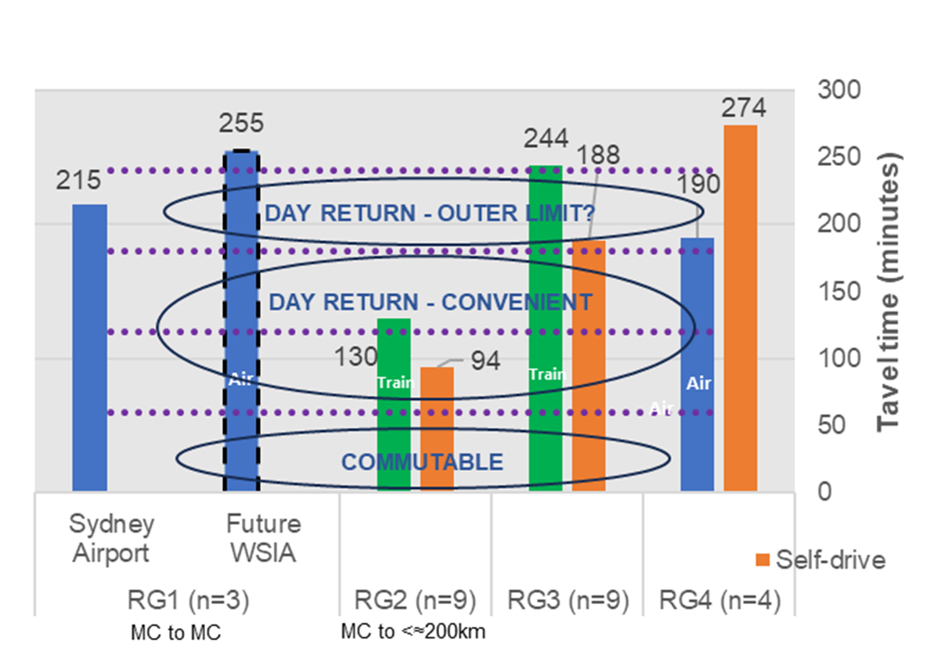
RG2 Trains miss the commute benchmark and, slower than self-drive, add to road congestion
Transport economics and policy analysis – connecting people, goods and places.
Notes:
In route geography 2, only two regional centres, Gold Coast and Ballarat, have average train speeds faster than self-drive and in Gold Coast’s case that’s because driving speeds are themselves low due to road congestion.
No regional centre has a service time within the 60 minute benchmark, so current arrangements effectively lock in increasing road congestion.

Slide 12

RG3 Trains are too slow for viable day return, air is mostly absent, even self-drive can be lengthy
MC to 200-350km
MC to 350-450km
Transport economics and policy analysis – connecting people, goods and places.
Notes:
Whereas self-drive works for day return purposes in RG2, nothing completely works in RG3, at distances from 200 km tops to 350 km from major capitals.
Trains are too slow for viable day return – for example five and a half hours from Taree to Sydney – air isn’t present, other than at Canberra – and even self-drive can be lengthy, ie just under four hours from Taree.

Slide 13
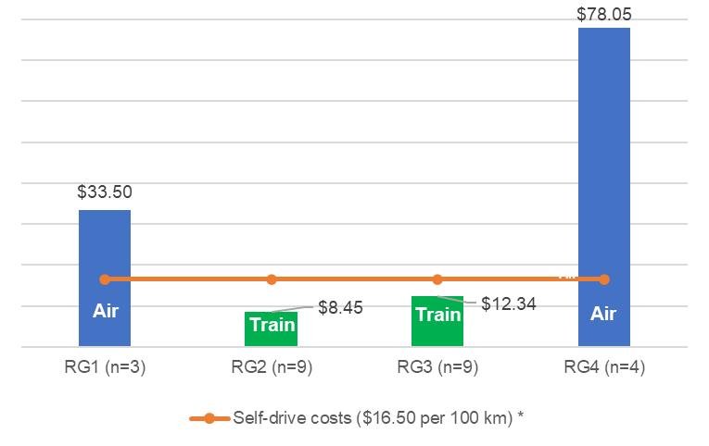
RG4 Air allows day return but is costly, major capital airport capacity pressures also impinge
* Fuel, servicing and tyre costs for a 2023 Toyota Camry
Transport economics and policy analysis – connecting people, goods and places.
Notes:
Finally, in RG4, at distances between 350 and 450 km, air offers a three hour city centre to city centre day return time. This is invaluable, but it’s also costly, with small aircraft in use and economies of traffic density not available.
Also peak period slots reserved for regional airlines at Sydney Airport haven’t increased since the scheme was established in 2001. A proposal is going through Parliament at the moment to slightly free that up, so we can wait and see how that works out.

Slide 14
Solutions – in RG1, ‘fast enough’ HSR would offer new well-sited capacity, relieving Sydney Airport
Route geography | City pair | Rail distance km (est.) | SERVICE TIMES (MINS)
 | Maximum speed kph |  | 200 | 250 | 300 | 350
 | RG2 average speed kph (0.6 av/max) |  | 120 | 150 | 180 | 210
 | RG3-4 average speed kph (0.75 av/max) |  | 150 | 188 | 225 | 263
RG1 | SYDNEY - MELBOURNE | 824 | 356 | 284 | 237 | 203
RG2 | Bowral-Mittagong – Sydney | 100 | 50 | 40 | 33 | 29
RG3 | Goulburn – Sydney | 179 | 82 | 65 | 54 | 47
RG3 | Canberra-Queanbeyan – Sydney | 280 | 122 | 98 | 81 | 70
RG4 | Wagga Wagga – Sydney | 411 | 174 | 140 | 116 | 100
RG3 | Albury-Wodonga – Melbourne | 296 | 134 | 108 | 90 | 77
RG3 | Wangaratta – Melbourne | 235 | 110 | 88 | 73 | 63
RG2 | Shepparton-Mooroopna – Melbourne | 160 | 80 | 64 | 53 | 46
RG1 | MELBOURNE-SYDNEY | 824 | 356 | 284 | 237 | 203
≤1 hour
≤2 hours
≤3 hours
≤3½ hours
Transport economics and policy analysis – connecting people, goods and places.
Notes:
So how can high speed rail, or sub high speed rail, address these problems?
The far right column shows a notional service time of 3 hours 23 minutes between Sydney and Melbourne for a train with a top speed of 350 kph.
The table also includes three lower speeds, 300, 250 and 200 and, moving to the left, you can see that the estimated service times are around 4 hours, 5 hours and 6 hours respectively.
A broad assumption is that all of these are stopping rather than non-stop services, so express services might well improve on the 3 hours 23. But the table does suggest that services with lesser top speeds mightn’t be quite fast enough.

Slide 15
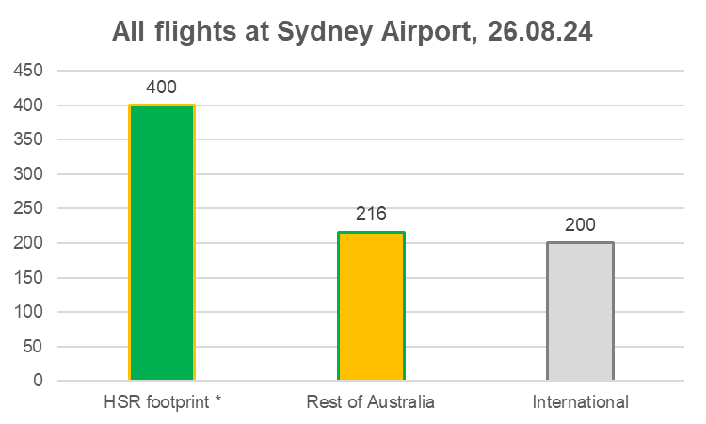
Airport capacity relief benefits would accrue outside, as well as inside the HSR footprint
* 'East coast' only and excluding Adelaide flights
Transport economics and policy analysis – connecting people, goods and places.
Notes:
In addition, if air-competitive services operating at a conveniently sited station or stations can be provided, airport capacity relief should benefit locations outside the high speed rail footprint, as well as those within it.
Just under half of flights at Sydney Airport are within the footprint – excluding Adelaide here, as a Melbourne-Adelaide HSR link would be unlikely to reduce flights between Sydney and Adelaide. So if 50 per cent of footprint flights at the airport were no longer required, that would release around a quarter of the airport capacity for flights to and from elsewhere, including overseas.
This is an important – and often overlooked – aspect of the broad national case for high speed rail.

Slide 16
RG2: 250 kph trains will be faster than self-drive, close to a 1 hr commuting benchmark
Route geography | City pair | Rail distance km (est.) | SERVICE TIMES (MINS)
 | Maximum speed kph |  | 200 | 250 | 300 | 350
 | RG2 average speed kph (0.6 av/max) |  | 120 | 150 | 180 | 210
 | RG3-4 average speed kph (0.75 av/max) |  | 150 | 188 | 225 | 263
RG1 | SYDNEY - MELBOURNE | 824 | 356 | 284 | 237 | 203
RG2 | Bowral-Mittagong - Sydney | 100 | 50 | 40 | 33 | 29
RG3 | Goulburn - Sydney | 179 | 82 | 65 | 54 | 47
RG3 | Canberra-Queanbeyan - Sydney | 280 | 122 | 98 | 81 | 70
RG4 | Wagga Wagga - Sydney | 411 | 174 | 140 | 116 | 100
RG3 | Albury-Wodonga - Melbourne | 296 | 134 | 108 | 90 | 77
RG3 | Wangaratta – Melbourne | 235 | 110 | 88 | 73 | 63
RG2 | Shepparton-Mooroopna - Melbourne | 160 | 80 | 64 | 53 | 46
RG1 | MELBOURNE-SYDNEY | 824 | 356 | 284 | 237 | 203
≤1 hour
≤2 hours
≤3 hours
≤3½ hours
Transport economics and policy analysis – connecting people, goods and places.
Notes:
In contrast to RG1, in RG2, for a destination such as Shepparton, 250 kph trains are close to being fast enough to deliver one hour service times to Melbourne that are favourable for commuting. Shepparton’s self-drive time is 2 hours 11 minutes, so even at the lowest speed in the table, 200 kph, there would be a large time saving relative to driving.

Slide 17
RG3 & 4: At 250 kph, no regional centre is >2½ hrs from the nearest major capital – suits day return
Route geography | City pair | Rail distance km (est.) | SERVICE TIMES (MINS)
 | Maximum speed kph |  | 200 | 250 | 300 | 350
 | RG2 average speed kph (0.6 av/max) |  | 120 | 150 | 180 | 210
 | RG3-4 average speed kph (0.75 av/max) |  | 150 | 188 | 225 | 263
RG1 | SYDNEY - MELBOURNE | 824 | 356 | 284 | 237 | 203
RG2 | Bowral-Mittagong - Sydney | 100 | 50 | 40 | 33 | 29
RG3 | Goulburn - Sydney | 179 | 82 | 65 | 54 | 47
RG3 | Canberra-Queanbeyan - Sydney | 280 | 122 | 98 | 81 | 70
RG4 | Wagga Wagga - Sydney | 411 | 174 | 140 | 116 | 100
RG3 | Albury-Wodonga - Melbourne | 296 | 134 | 108 | 90 | 77
RG3 | Wangaratta – Melbourne | 235 | 110 | 88 | 73 | 63
RG2 | Shepparton-Mooroopna - Melbourne | 160 | 80 | 64 | 53 | 46
RG1 | MELBOURNE-SYDNEY | 824 | 356 | 284 | 237 | 203
≤1 hour
≤2 hours
≤3 hours
≤3½ hours
Transport economics and policy analysis – connecting people, goods and places.
Notes:
It’s open for debate how relevant it is to focus on the service times achievable at 250 kph for locations further from the major capitals in RG3 and RG4. That’s because these imply five hour Sydney-Melbourne times which wouldn’t be air-competitive – for time-sensitive passengers at least – and the services therefore might never be contemplated.
However, if they did eventuate, all of the regional centres would have service times within two and a half hours – which are still very positive for day return travel, particularly with higher ‘through’ service frequencies likely than with air.

Slide 18
Resulting opportunities
CONTRIBUTE TO
Population growth shift to regional centres
Better business productivity
Improved in-region specialist health service access
Net zero emission transport
Transport economics and policy analysis – connecting people, goods and places.
Notes:
I identify four resulting opportunities.
First, by extending commutable distances , there are opportunities for housing supply that would be newly within range of jobs in major capitals. So that’s, if you like, the first round of population growth shift towards regional centres.
Secondly, by reducing the time costs of travel between separate cities to very low levels, there are new opportunities for business reorganisation, growth and specialisation.
Thirdly, hospitals in smaller regional centres rely critically on visiting medical specialists who are based in the capital cities. There’s a role for high speed and sub high speed rail in underpinning aspects of the basic social functioning of a number of regional centres.
Finally, assuming future zero emission electric powering, high speed rail can contribute to a net zero emission transport sector through mode switching from air to rail. This opportunity arises from the uncertainty about both pathway and timing for decarbonisation of large passenger jet aircraft.

Slide 19
Opportunities by route geography – some ‘in principle’ differences
Opportunity | MAJOR CAPITAL TO
 | Adjoining major capital RG1 |  | End point of frequent train service (≤200 km) RG2 |  | ≤200 km-350km, most w/o air * RG3 |  | 350-450 km, with air RG4
Max operating speed kph | 200-250 | 300-350 | 200-250 | 300-350 | 200-250 | 300-350 | 200-250 | 300-350
CONTRIBUTE TO
1. Population growth shift |  |  | ✓ | ✓ |  | ✓
2. Better business productivity | ? | ? | ✓ | ✓ | ✓ | ✓ | ✓ | ✓
3. Better in-region specialist health services |  |  |  |  | ✓ | ✓
3. Net zero emission transport | ✓ | ✓ |  |  | ✓* | ✓* | ✓ | ✓
Canberra-Queanbeyan has frequent air service
Transport economics and policy analysis – connecting people, goods and places.
Notes:
There isn’t time to go through the list of opportunities route geography by route geography, so I’ll confine myself to the ‘better business productivity’ opportunity where you’ll see question marks for major capital to major capital on the left and ticks in all the regional route geographies.
The literature emphasises the idea of ‘economic convergence’ between larger wealthier cities and smaller ones through high speed rail and the regional RG ticks are consistent with that. Impacts in the larger cities are less clear.
However with Sydney and Melbourne having grown faster than the rest of the country over the past 30 years, alongside comparablyy rapid growth in air travel between these cities, I wouldn’t dismiss the idea of positive productivity impacts in these cities through high speed rail, as well as in regional centres.

Slide 20
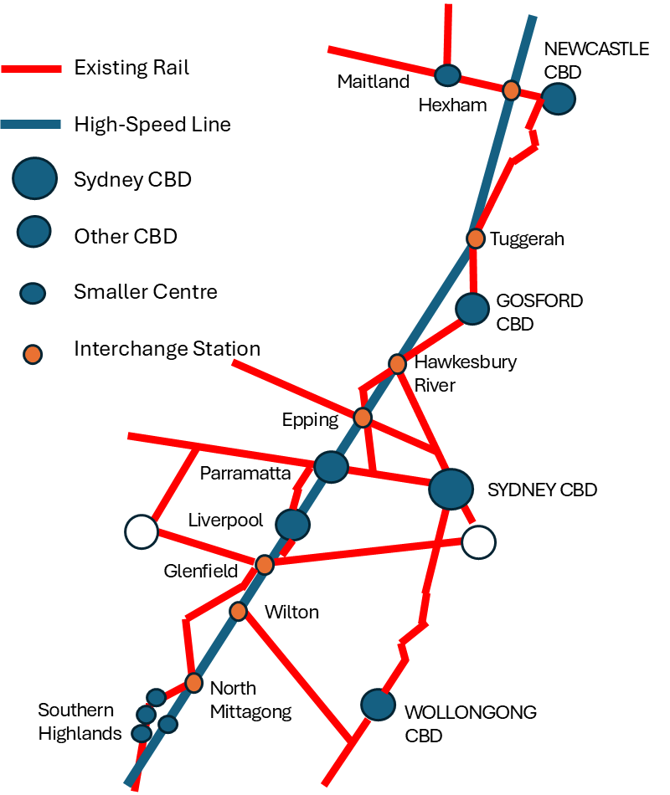
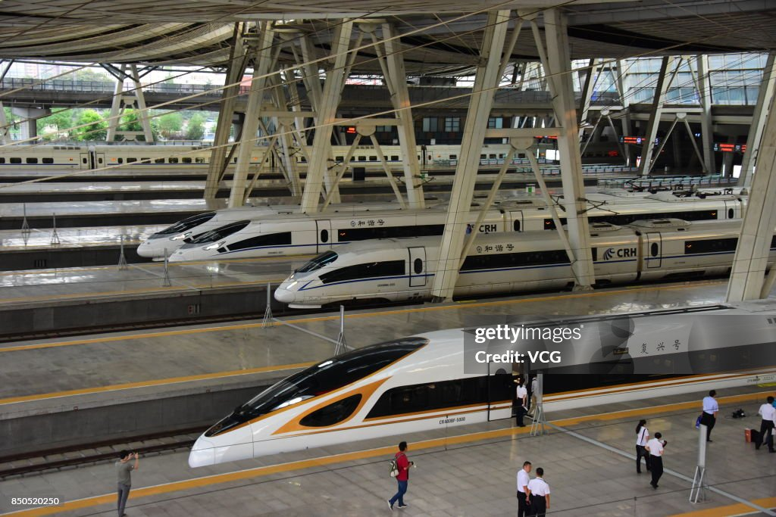
Business case implications: 1. Help identify operational, service requirements
RG1 Trains fast enough to compete
RG2 Convenient access for residents
Beijing-Shanghai Fuxing Bullet Train (350 kph)
Source: Glazebrook, G 2024, Integrating our Mega-Regions:
Implications for Sydney-Newcastle High Speed Rail, Fastrack Australia
Transport economics and policy analysis – connecting people, goods and places.
Notes:
Finally, I see three main sets of implications for business cases: helping specify the project, helping specify the strategic case for the project and – hopefully at this stage, as we’ll need to see how this plays out – informing the analysis.
In terms of specifying the project, the slide points to two examples.
The problem/opportunity mix of RG1 calls for trains that can reach speeds that achieve air-competitive times, while the problem/opportunity mix of RG2 points to the importance of maximising access to fast service times for residents. This could be either through having closer spaced stations on the line, or through trains operating on the high speed line also being able to traverse existing lines.

Slide 21
2. Acknowledge diverse policy objectives
Route geography | 'Direct' (transport) policy objective | 'Indirect' (opportunity) policy objective
RG1 | Ensure an efficient national air transport system by adding well located, air-competitive HSR capacity | Net zero emission transport; economic growth
RG2 | Reduce regional road congestion with a faster, more reliable alternative public transport option | Job-accessible and affordable housing supply; economic growth
RG3 | Overcome the problem of lengthy business and other day trips by all modes, including self-drive | Regional health workforce challenge; economic growth
RG4 | Offer a business day trip alternative to costly air transport | Economic growth
Transport economics and policy analysis – connecting people, goods and places.
Notes:
Secondly, the route geographies can help acknowledge the diversity of policy objectives for high speed rail. This is important for the strategic business case.
I’ve identified four transport policy objectives in the table and I’d argue that each is best understood in relation to one specific route geography, rather than to high
speed rail more generally.
The objectives are: strengthening the nation’s air transport system in RG1, reducing or preempting road congestion in RG2, introducing convenient day return travel in RG3 and reducing the cost of day return travel in RG4.

Slide 22
3. Improve the link between analysis and ‘direct’ and ‘indirect’ policy cases
  Travel demand analysis
  Wider economic impacts analysis
  Valuing transport (‘direct’) and opportunity (‘indirect’) benefits
  Cost estimation
Transport economics and policy analysis – connecting people, goods and places.
Notes:
And thirdly I’d expect that both demand analysis and economic analysis can be enhanced through focusing on the route geographies.
But appraisal methodology is a topic of its own.
I’ll leave it there, other than to note that background research in two areas could be particularly helpful: research into day return travel in Australia by all modes and into business location decisions, including the relationship with business travel options.

Slide 23
  Thank you
  Questions
Transport economics and policy analysis – connecting people, goods and places.

